Slide 1
BECOMING AN OWNER DEVENIR PROPRIETAIRE
APPARTEMENT – VILLA – PRÊT HYPOTHECAIRE – ACHAT SUR PLANS
VILLA – APPARTEMENT – LOAN & MORTGAGE – BUYING ON PLANS

Slide 2
LOI FEDERALE SUR L’ACQUISITION D’IMMEUBLES PAR DES PERSONNES A L’ETRANGER (LFAIE)
SWISS CITIZENS
EU CITIZENS WITH LEGAL DOMICILE IN SWITZERLAND
AUTHORIZATION
FOR « FOREIGNERS » => « C PERMIT »
FOR DIPLOMATS => EQUIVALENT « C PERMIT » - USA 5 YEARS

Slide 3
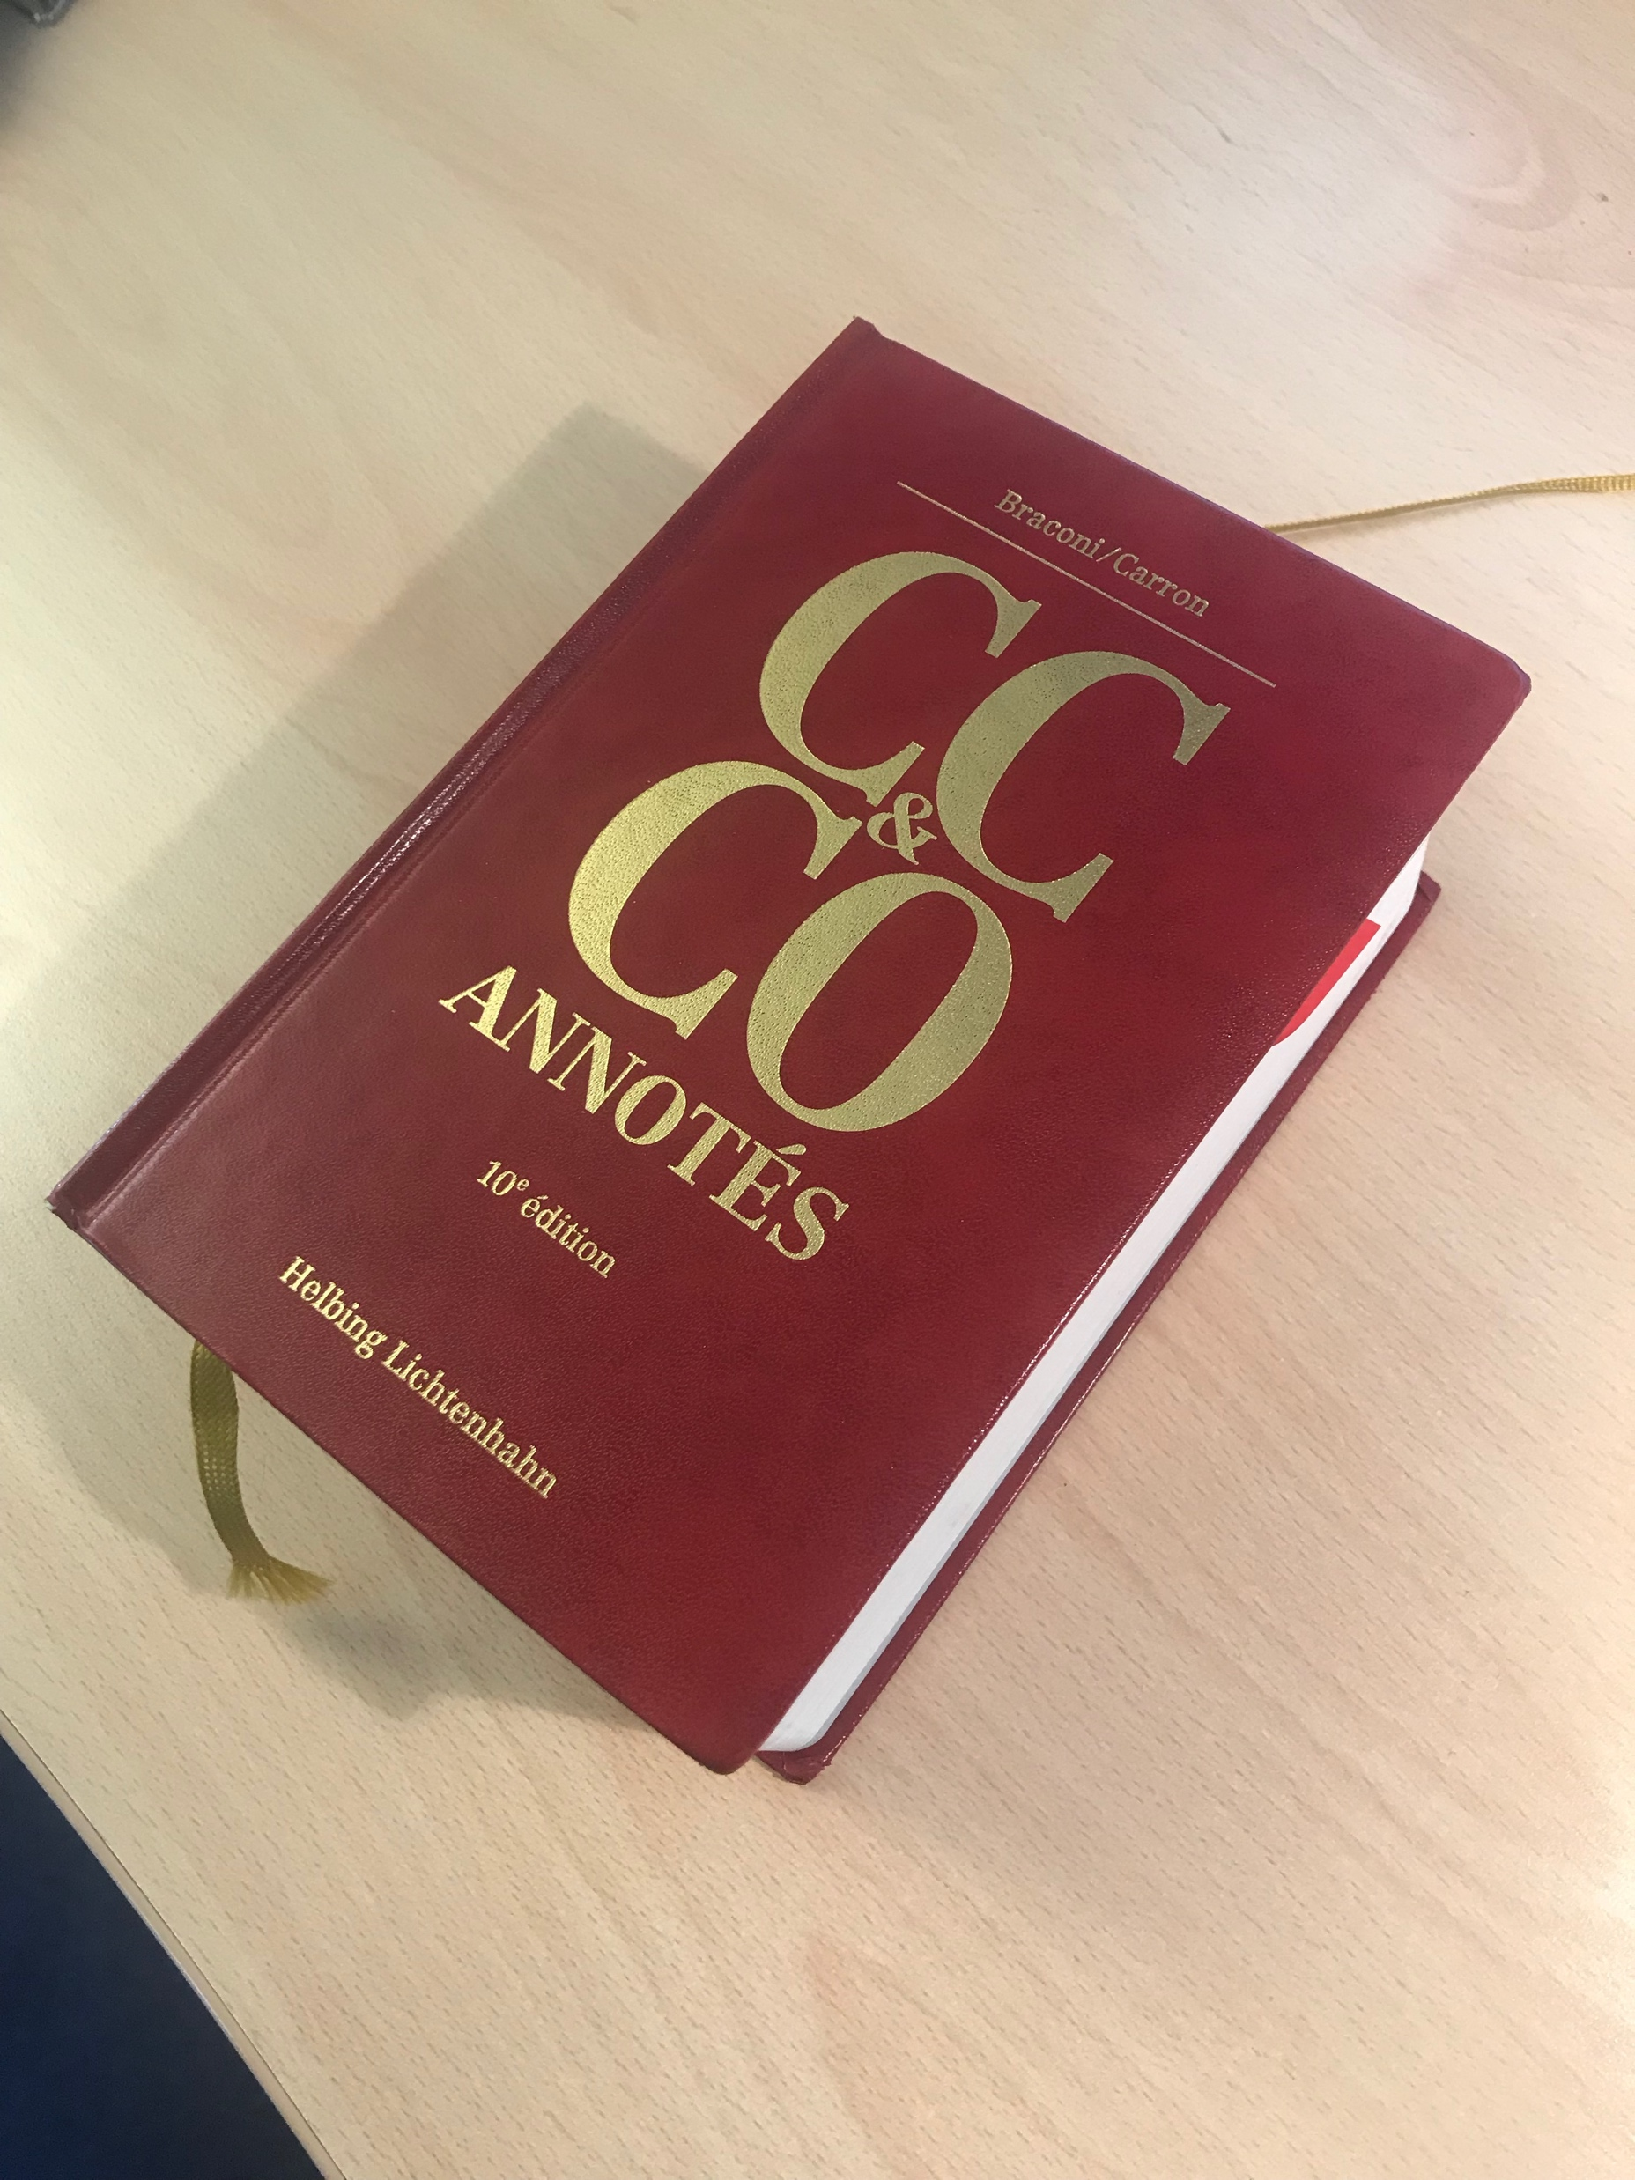
CIVIL CODE – ownership – CONSTITUTION
ART. 26 SWISS CONSTITUTION – GUARANTEE => PROTECTION AGAINST STATE « INVASION »
ART. 655 and Subs. CIVIL CODE – LAND PROPERTY – PLOTS – AREA - MINES – CO-OWNERSHIP
VEHICLES – MEANS TO BECOME AN OWNER
Personal ownership
Individual
Co-Ownership i.e. Floor ownership (« Copropriété par étage » or « PPE »)
Through company (Ldt Co. « société immobilière » or « Cooperative »)

Slide 4
CONTRACT – CODE OF OBLIGATIONS
ART. 216 and Subs. SWISS CODE OF OBLIGATION
NOTARY ⬄ « ACTE AUTHENTHIQUE » ⬄ S&P AGREEMENT OR TERM AGREEMENT OR PROMISE TO BUY
PRICE
USUAL FINANCING : 80% - 20%
LOAN AGREEMENT – BANK + GUARANTEE = MORTGAGE

Slide 5
CONTRACT – Specific points
FLAT => CO-OWNERSHIP (« PPE ») or LTD. CO. or COOPERATIVE
TAX BEFORE (cf. Stéphane TANNER’s presentation)
USUAL FINANCING : 80% - 20% (max 10% FINMA req. on 2nd Pilar)
LOAN AGREEMENT – BANK => INDIRECT AMORTIZATION via 3rd pilar
TAX AFTER on Real Estate Profit

Slide 6
CONTRACT – Specific points
BUYING « ON PLANS »
- SALE & PURCHASE AGREEMENT (PLOT)
- CONSTRUCTION CONTRACT (art. 363 and Subs. CO - SIA 118) - AND SUB-CONTRACT(S) FOR BUILDING
- GUARANTEES (CONSTRUCTION AND SURFACE)

