Slide 1
Tpg Crisis management and after
Anne Hornung-Soukup
Chair of the Board of Directors Transports publics genevois (tpg)
April 23rd, 2020

Slide 2
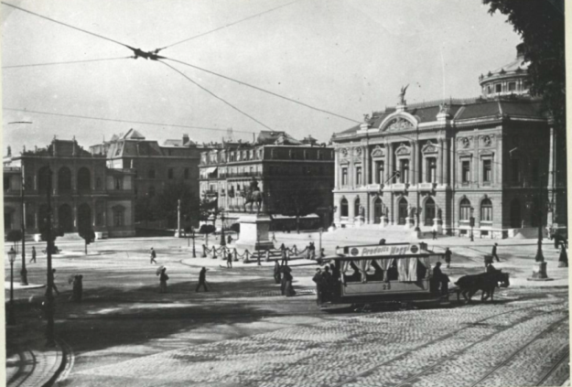
History of tpg
Geneva Mass Transit Milestones and Eras
19th Century – Innovation
1833 First omnibus launched
1862 First horse-drawn tramway line Line 12: historic, oldest still operating in Europe
1878 First steam-powered tram
1896 First electric tram
20th Century – Wars and Cars
1920 Peak of Geneva tram lines
1977 Takeover by the State of Geneva
21st Century – First 20 years: Renewed Growth
2020 COVID-19
Place de Neuve, 1894

Slide 3
Tpg today – COVID-19
Facts and figures – March-April 2020
Public transport declared essential service by Swiss Federal Council
Passengers/day down 85%
Bus/tram services reduced by 50%
400 tpg employees working from home
Drivers are separated from passengers, wipe down cabin, vehicles cleaned several times/day, buses parked at train station to provide more space for driver breaks

Slide 4
Tpg today – COVID-19
Projects on pause, will resume
En Chardon depot/maintenance center near airport will be largest in Switzerland
Extension of tram lines past Bernex and to Grand-Saconnex
Autonomous vehicle line in Meyrin halted, not enough space in vehicle for necessary distance between passengers

Slide 5
Tpg tomorrow
Crisis and after
Worst
- Deaths/illness/overwhelmed health systems
- Economic disruption: massive unemployment/bankruptcies/precarity
- Political instability
- Mass transit - difficult to respect social distance guidelines
Silver linings
- Clean air & water/reduced pollution & noise
- Realization that many important employees are among the most precarious
- Realization that too much urban space is devoted to cars
- Streets being re-appropriated worldwide for people, children, bikes
- Mass transit is a vital part of post-crisis solutions

Slide 6
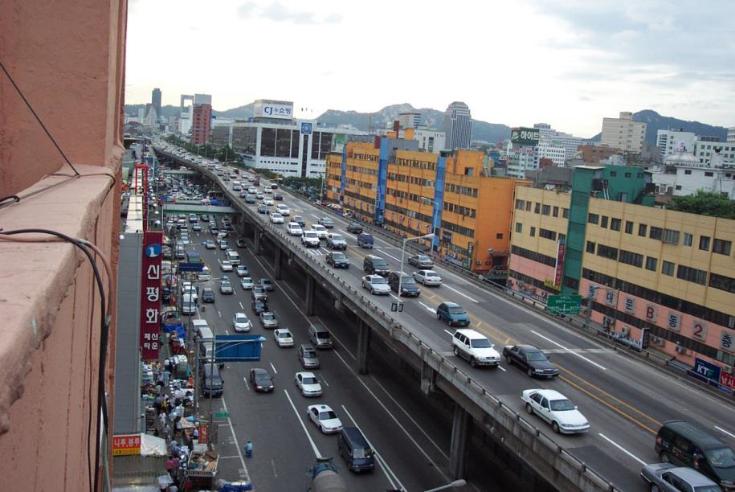
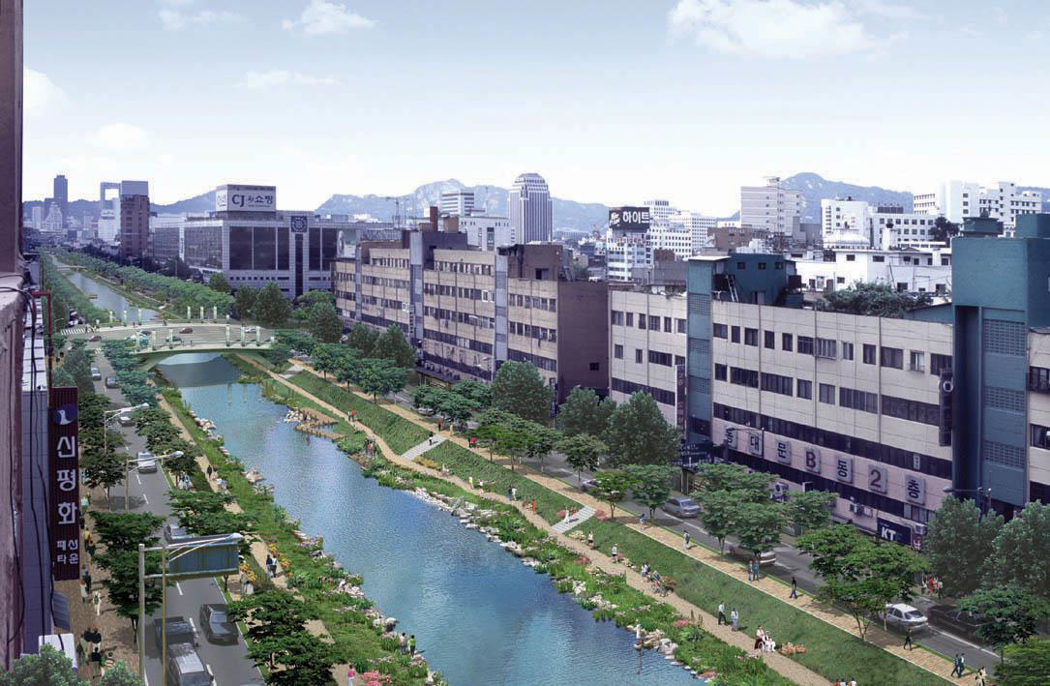
Hope for spread of post-crisis urbanism
Seoul, Korea
20th century: Construction for cars 21st century: Construction for people
Dust, dirt, air pollution
Congestion, noise, urban heat
Social isolation, one person per car
35% reduction in fine particles
5° reduction in temperature
60’000 visitors a day

Slide 7
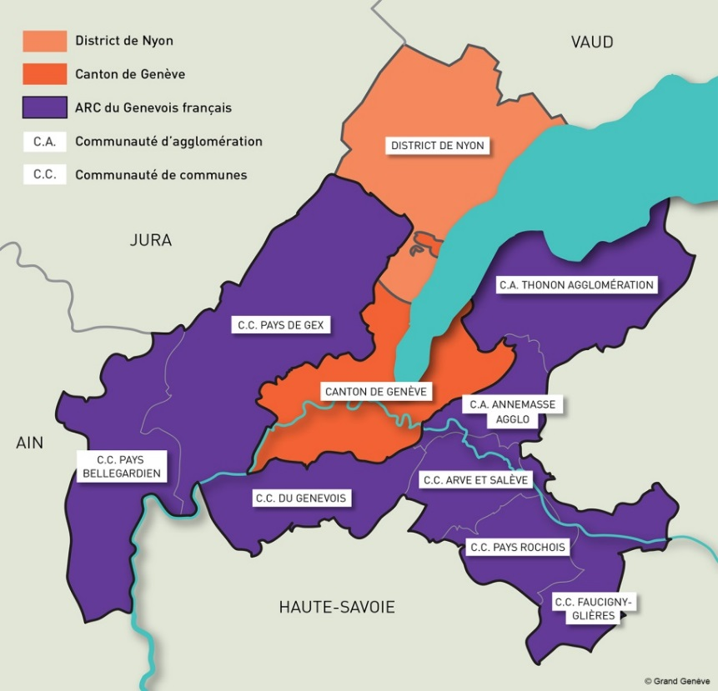
Smart Sustainable Region
During the crisis, public transit is absolutely vital for people who work in essential services.
As the world emerges from this crisis, it is evident that the economic and social models
we’ve accepted for so long should and can be changed to make the world more stable, healthier,
and more sustainable.
Conctact tpg to give suggestions/observations:
00800 022 021 20
www.tpg.ch

